Slide 1
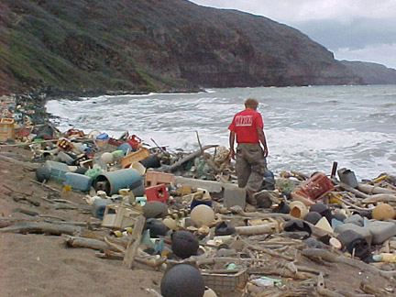
‘Plastic products and ecological environment protection in daily life’
Social Change Solution Campaign

Slide 2
Contents
01 Social Marketing Problem
02 Customer Behavior Problems
03 Empathy Map
04 Behavior Change Objectives
This Photo by Unknown Author is licensed under CC BY-SA

Slide 3
1
Social Marketing Problem
Pollution caused by plastic products are negatively affecting our environment (oxford, 2018).
At least 267 species of marine organisms world wide were affected by plastic wastes that flowed into oceans(Charles, 2008).
Most species of seabirds ,sea turtles and other marine mammals have been involved in the case of entanglement or ingestion of plastic (oxford, 2018).
The microproduct formed by plastics in the ocean will accumulate in through the food chain of marine organisms (Nano, 2016).
The surface water around Australia has been polluted by microplastic and the plastic hazards to Australia species and ecological communities are likely to be broader than those officially recognized (Julia, 2013).
The recycling rate of plastic in Australia was only 9.4% while the plastic waste accounted for 4% of total waste (Fredrick, 2020).
Australia government has been aware of the severe challenge that plastics bring when they are being littered (Fredrick, 2020)

Slide 4

2
Customer Behavior Problems—Segments
Stressed Office Worker
(25-35 years old)(Ellison et at.,2010)
Living in urban areas
Under great pressure and stressed
(Eustace & Wei, 2010)
Enormous workloads, daily communicating,
and punctuality. (Quintanilla, 2008)
Pressured Perfect Mum
(40-50 years old) (Hakamies-Blomqvist, 1994)
With kids
work-family balance(Olah & Fratczak, 2013)
Care about education, safety of kids and her positive image within the“School mums” group (Adame et al, 2016).
Adventurous Senior
(65+ years old)(Hakamies-Blomqvist, 1994)
living in rural areas (CANSTAR, 2016)
Love hitting the roads to discover new places (Panagiotakos et al. 2011)
Slower reflexes, lower vision & hearing abilities (Musselwhite, 2016)
Fast & Furious
(17-25 years old) (Scott-Parker et al. 2012)
Living in rural areas (Young Driver Factbase, 2010)
Impulsive and thrill- seeking driving.
(Vassallo et al, 2013; The Social Issues Research Centre, 2004)
Care about their car, families and social status (Boteler, 2012).
CAMDEN
LOUIS PARKER
Community Impact Director

Slide 5
2
Customer Behavior Problems—Target Market
Fast & Furious
Demographic:
25-45 years old (Scott-Parker et al, 2012)
male
local/domestic resident
Geodemographic:
lives in rural areas in Australia (Young Driver Factbase, 2010)
Past Behavior:
Disposing plastics in marine oceans
burning plastic products near forests.

Slide 6
2
Customer Behavior Problems—Target Market
Fast & Furious
Attitudes:
impulsive; inexperienced (Vassallo et al, 2013)
thrill seeking; deliberately undertaking risky behaviors
(The social Issues Research Centre, 2004)
Irresponsible disposal of waste
peer pressured actions - impress and show off (NRHA, 2009)
Lifestyle:
heavy reliance on social media/phones (King, 2006)
engages in social activities (King, 2006)
loves visiting marine oceans
Interests & Values:
preserve ecological communities
high social status

Slide 7
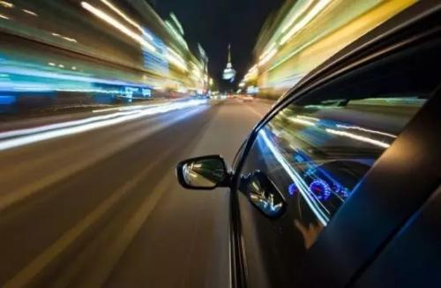
Empathy Map (Mitchell et al., 2010)
3
Said
Did
I didn’t realize there was danger in disposing plastic products in the oceans.
I have no time to dispose my waste to the right place due to my tight schedule.
Through my plastic water bottles and plastic papers in oceans after use.
Burn my waste near marine oceans
Felt
Thought
I can dispose my plastic waste to oceans to safe time
I can burn my plastic waste anywhere
I feel better when I have no plastic waste in my car, so I can through the plastics anywhere after use.
I felt better burning my plastic waste near marine oceans

Slide 8
4
Behavior Change Objectives
Specific
Measurable
Attainable
Realistic
Timely
Reduce the amount of disposable plastic in daily life to reduce the output of plastic waste
Increasing the use of products that can partly replace plastic , such as environmentally friendly bags, paper, straws and so on
Raising people’s awareness of the hazard of plastic litter.
Increase the recycle rate of plastic in Brisbane, Australia
Eventually promoting the correct recycling or disposal of most plastic waste in Brisbane
Aim
Start increasing the recycling rate of plastic waste

Slide 9
Reference List
Geyer, R., Jambeck, J. R., & Law, K. L. (2017). Production, use, and fate of all plastics ever made. Science advances, 3(7), e1700782.
Hammer, J., Kraak, M. H., & Parsons, J. R. (2012). Plastics in the marine environment: the dark side of a modern gift. Reviews of environmental contamination and toxicology, 1-44.
Dauvergne, P. (2018). The power of environmental norms: marine plastic pollution and the politics of microbeads. Environmental Politics, 27(4), 579-597.
Vince, J., & Hardesty, B. D. (2017). Plastic pollution challenges in marine and coastal environments: from local to global governance. Restoration Ecology, 25(1), 123-128.
Comăniță, E. D., Hlihor, R. M., Ghinea, C., & Gavrilescu, M. (2016). OCCURRENCE OF PLASTIC WASTE IN THE ENVIRONMENT: ECOLOGICAL AND HEALTH RISKS. Environmental Engineering & Management Journal (EEMJ), 15(3).

